Slide 1
Scientific
Teaching
Chris Meyer
York Mills C. I., Toronto
chris@meyercreations.com
This presentation is available at: www.meyercreations.com/physics

Slide 2

A
PHYSICIST

Slide 3
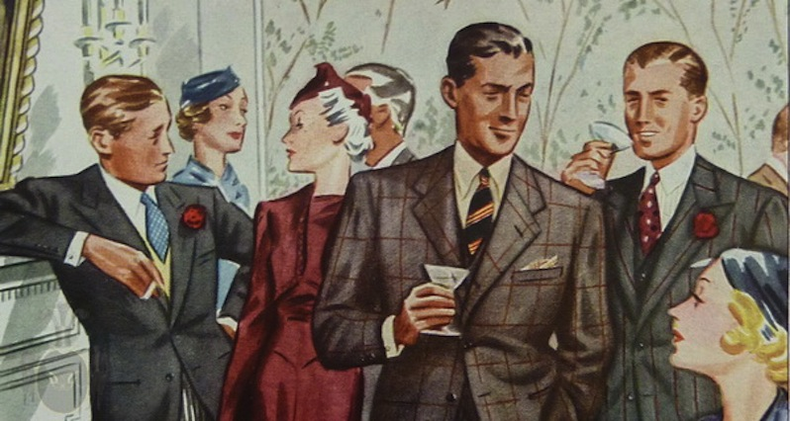
The Cocktail Party
Wow, physics, eh?
Physics was my worst subject.
Oh, I liked physics in school. But I didn’t do very well.

Slide 4
Physicists are Awesome!

Slide 5
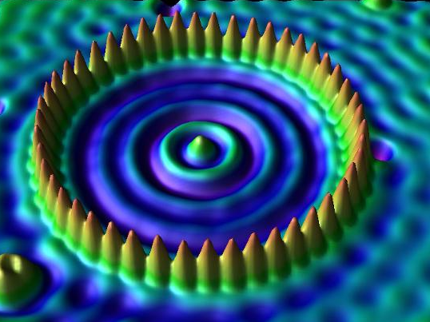

Slide 6
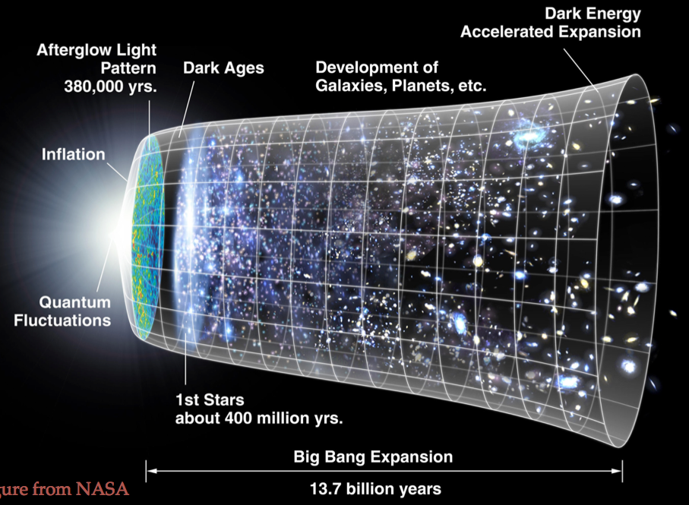

Slide 7
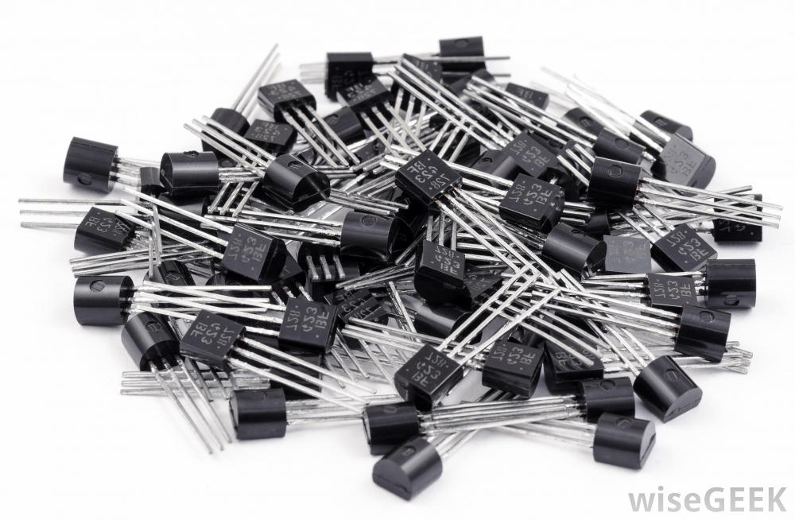

Slide 8
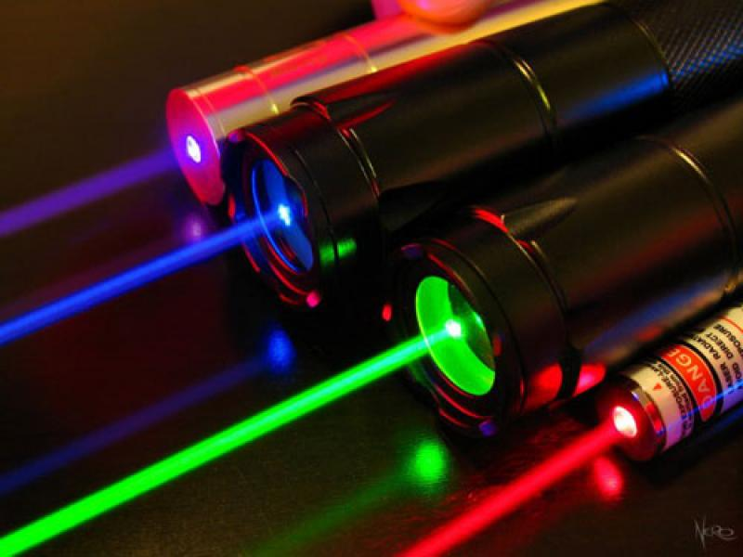

Slide 9
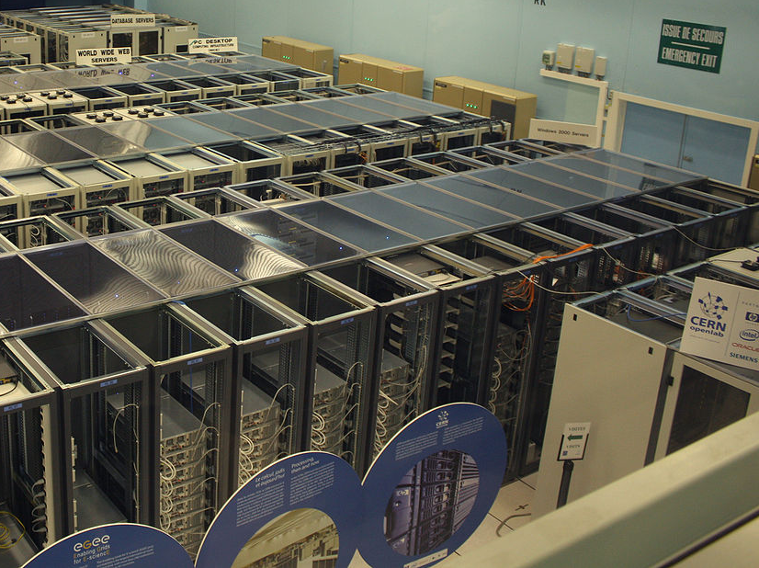

Slide 10
Physicists are Teachers!

Slide 11
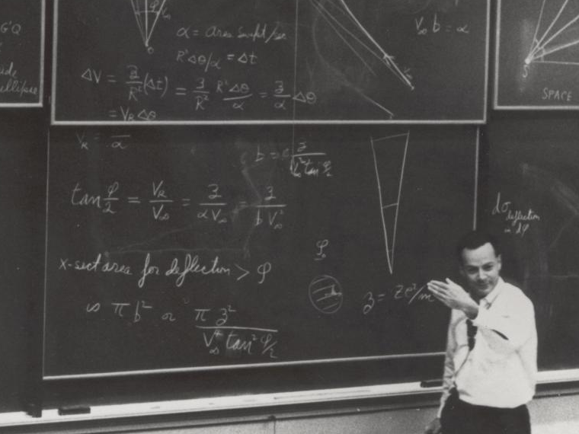

Slide 12
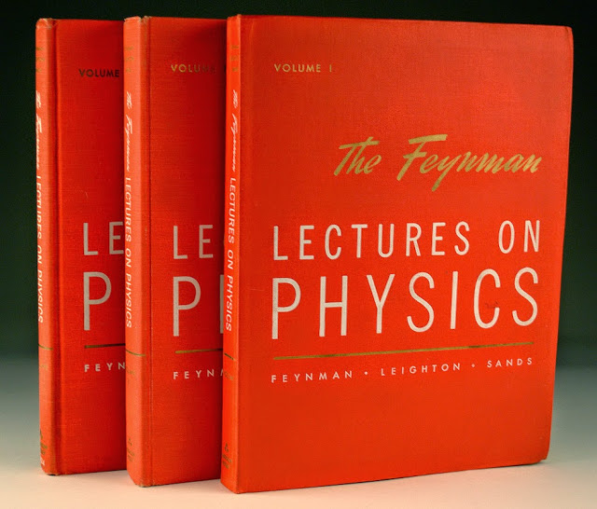

Slide 13
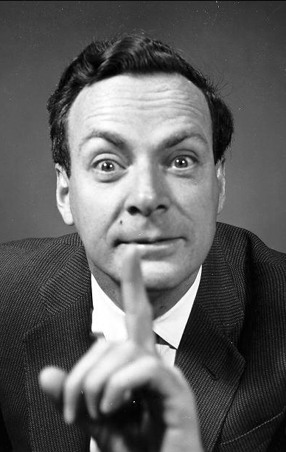
“There were one or two dozen students who – very surprisingly – understood almost everything …
These people have now, I believe, a first-rate background in physics – and they are, after all, the ones I was trying to get at.”

Slide 14
Physicists are Teachers!
and are still Awesome!

Slide 15
What about the other students?
How much are they learning?

Slide 16
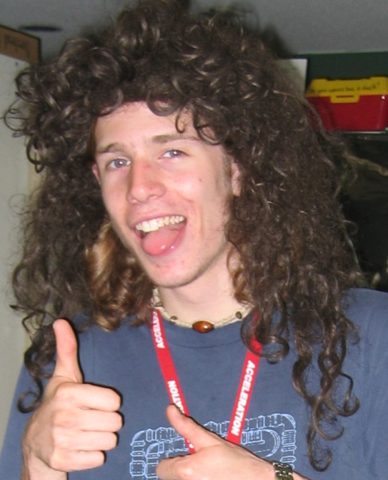
Physics Wisdom
?
Typical Student

Slide 17
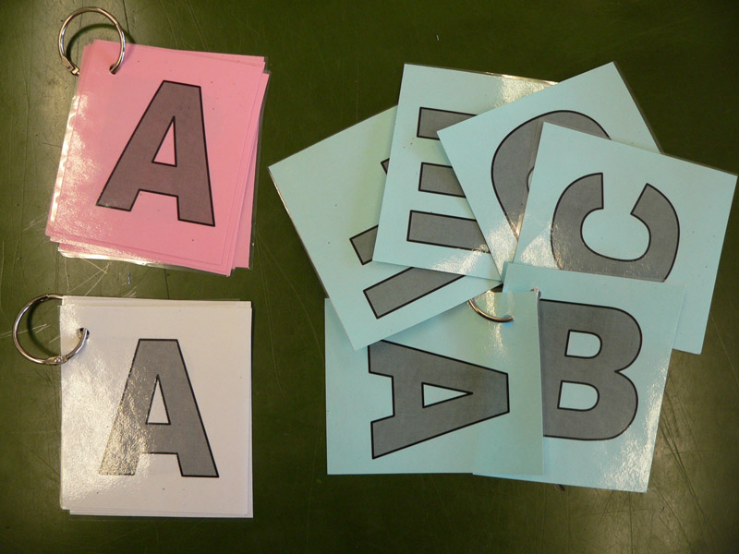
Find Your Answer Cards

Slide 18
Question Time!
Read the question
Choose an answer privately
Select (fold) your multiple choice response (keep it secret!)

Slide 19
Question Time!
What sector of the ESL world are you from?
A) LINC / Settlement
B) College / University
C) Private Language School
D) Some other, but really awesome part
E) Some other part

Slide 20
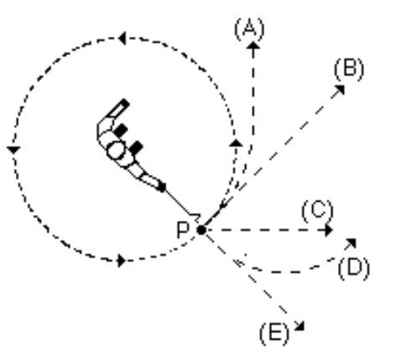
Question Time!
A ball on a string is swung in a horizontal circle.
At point P, the string breaks.
Which path would the ball most closely follow, observed from above?
A
B
C
D
E

Slide 21
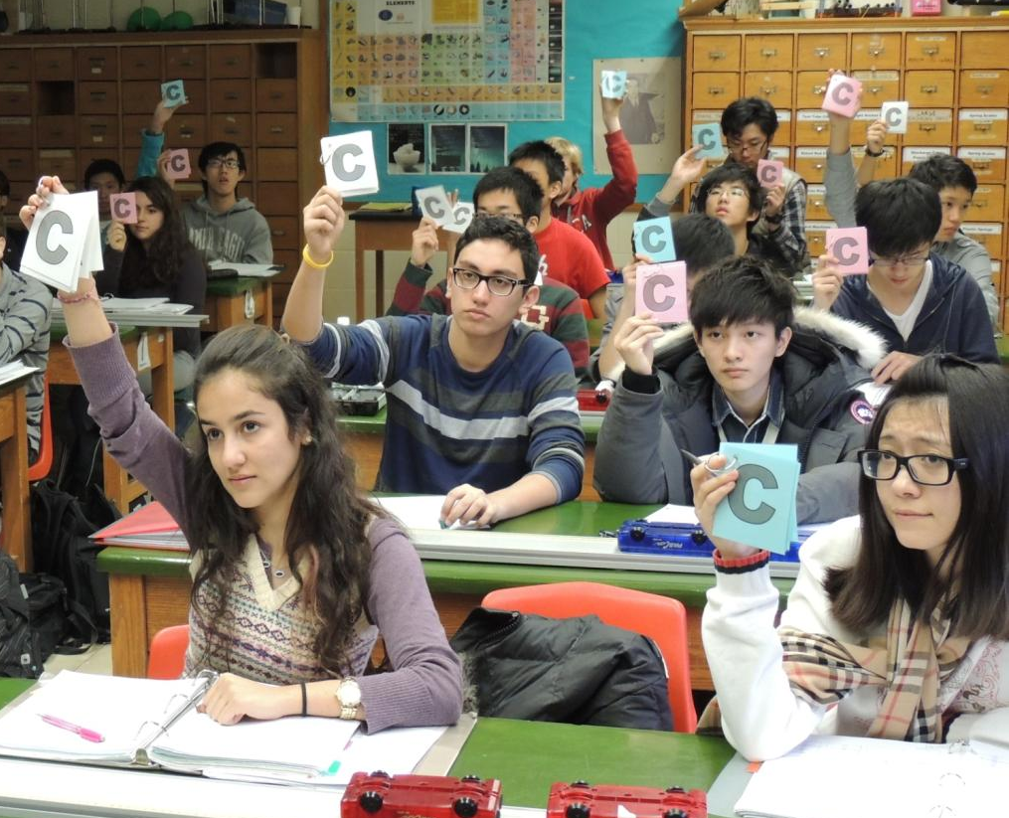

Slide 22
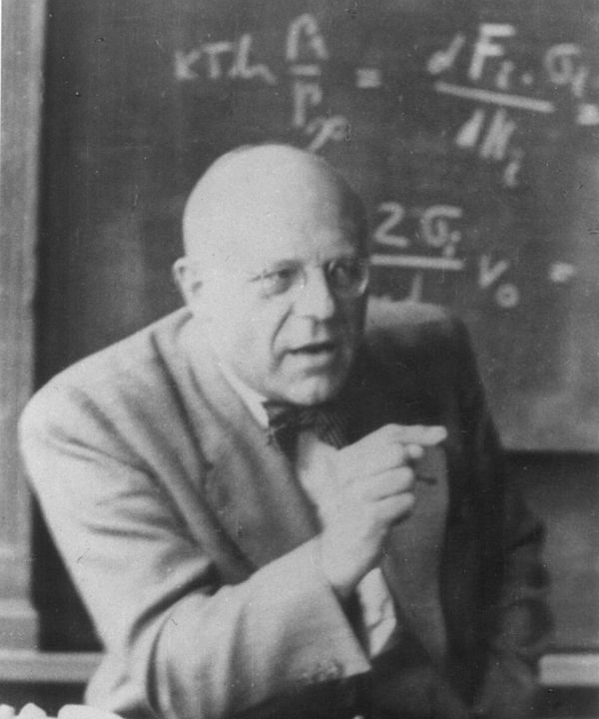
Way too easy!
Harrumph!

Slide 23
Physics Wisdom
23%
Out of their total possible improvement, they improve by 23%
Typical Student

Slide 24
Really not awesome!

Slide 25
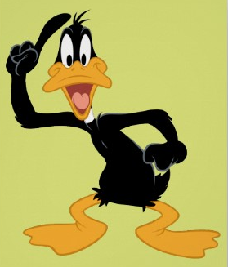

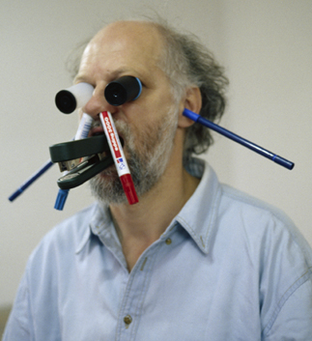
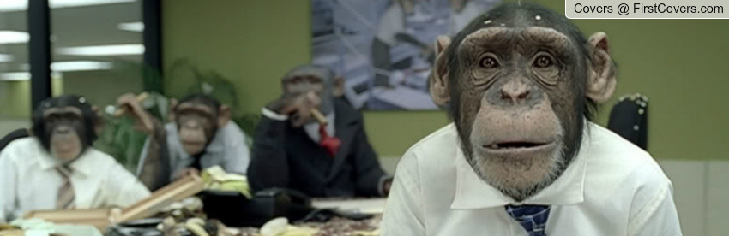
Best Lesson Ever

Slide 26
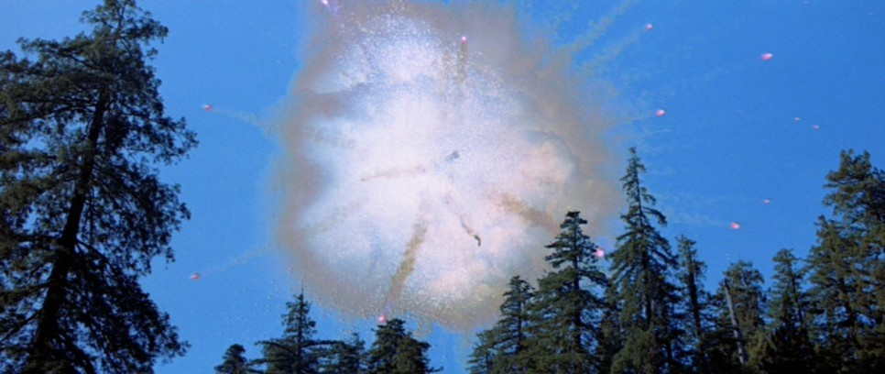

Slide 27
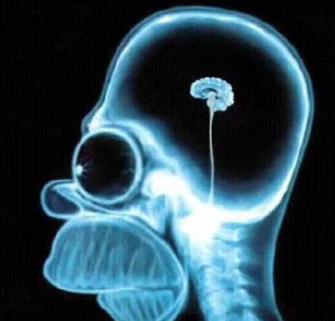
What’s Going on Upstairs?

Slide 28
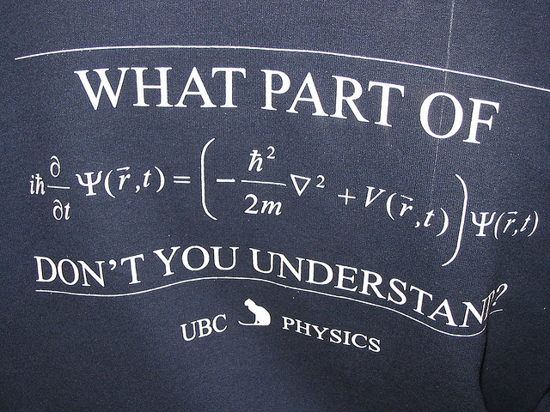
Physics is Hard

Slide 29
“There were one or two dozen students who – very surprisingly – understood almost everything …
These people have now, I believe, a first-rate background in physics – and they are, after all, the ones I was trying to get at.”

Slide 30
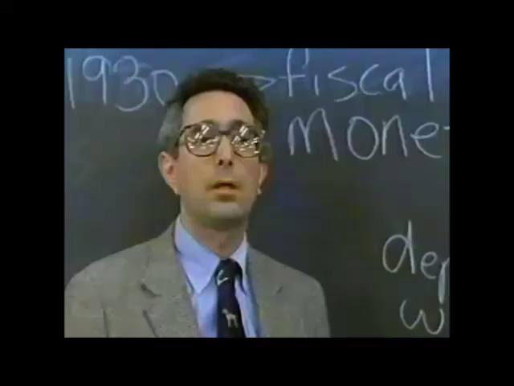

Slide 31
What’s Going on Upstairs?

Slide 32
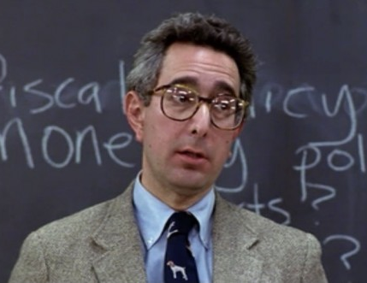
Bad
Teaching

Slide 33
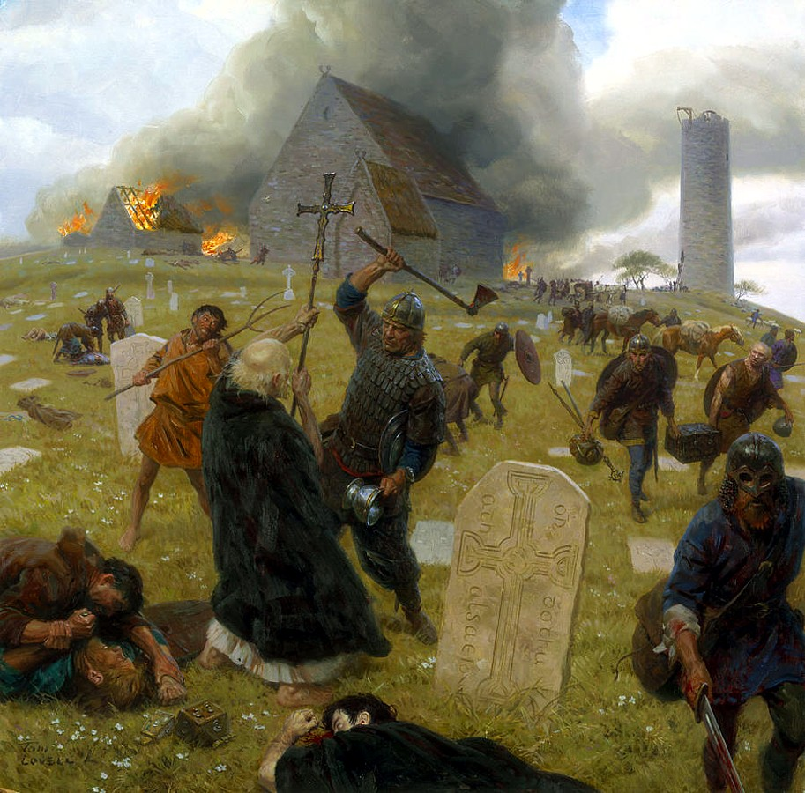
Educational Dark Ages
Traditional education is guided by:
Tradition!
Anecdote
Hunches
Trial and error

Slide 34
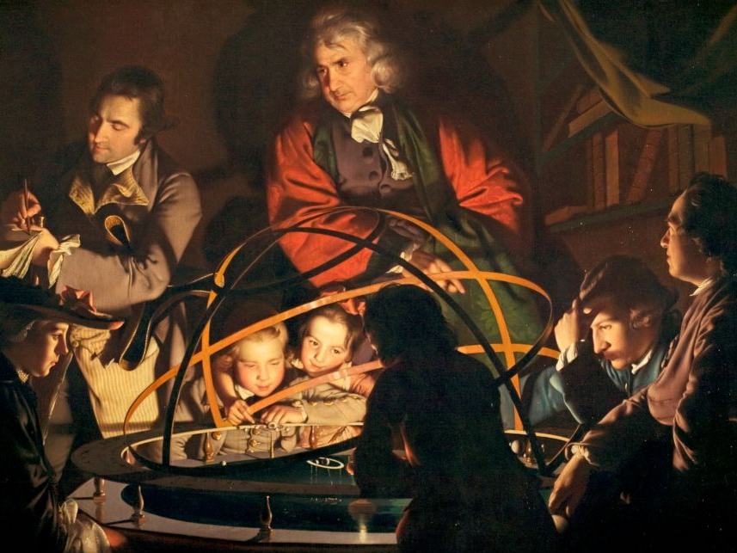
Scientific Revolution for Teaching

Slide 35
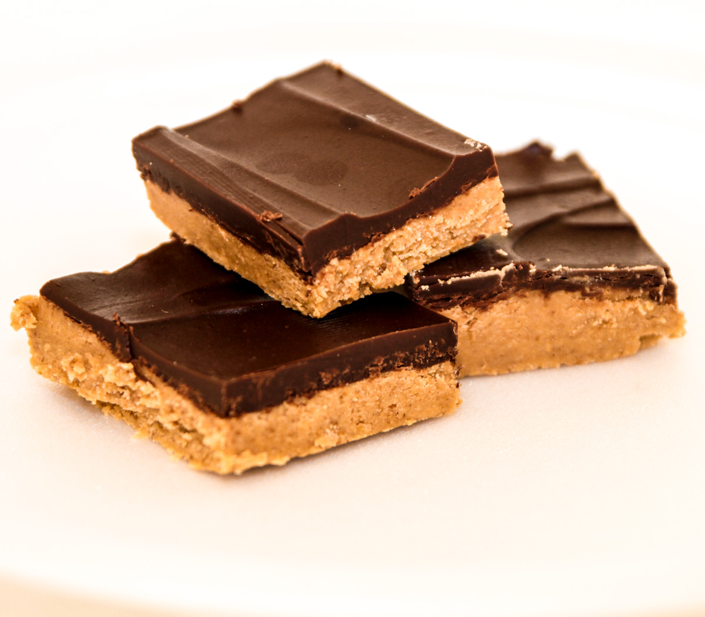
Chocolate (Science!)
+
Peanut Butter (Teaching)
= Teaching Science
= Scientific Teaching

Slide 36
Research
Model of Learning
Curriculum Development
Instruction

Slide 37
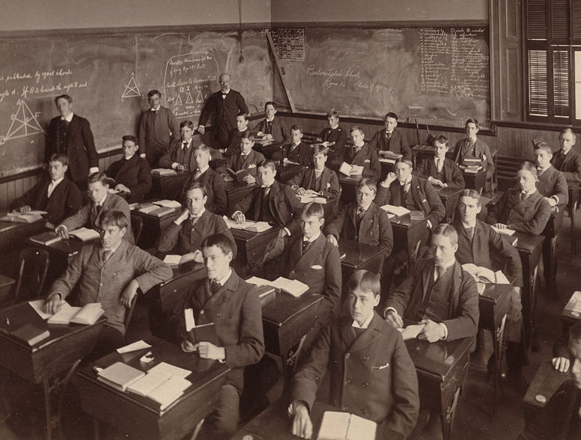
The Traditional Classroom

Slide 38
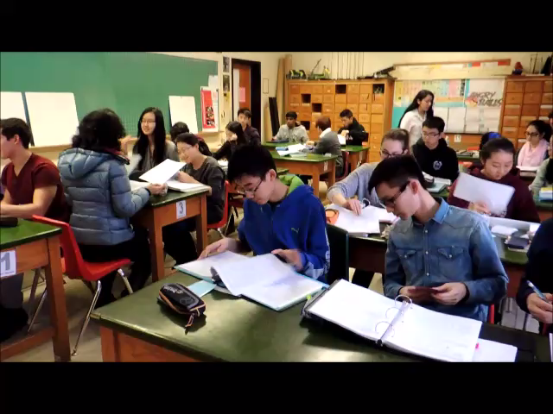
The Reformed Classroom

Slide 39
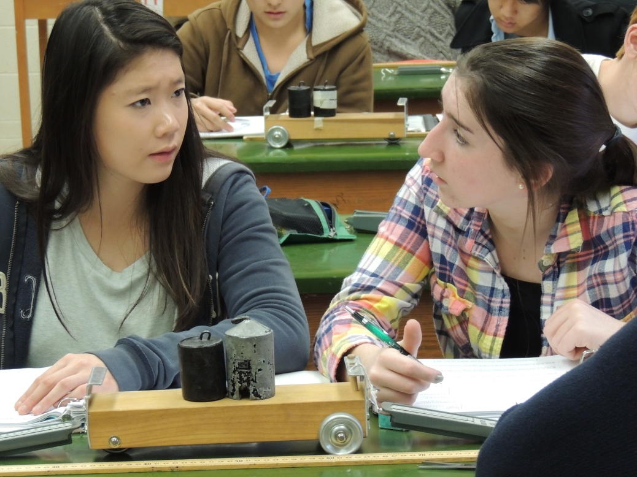
Through their own efforts, students must build their understanding through investigation, explanation and discussion.
Science!

Slide 40

The Role of the Teacher
We help them sort through the details.
We provide context, insight and meaningful practice.

Slide 41
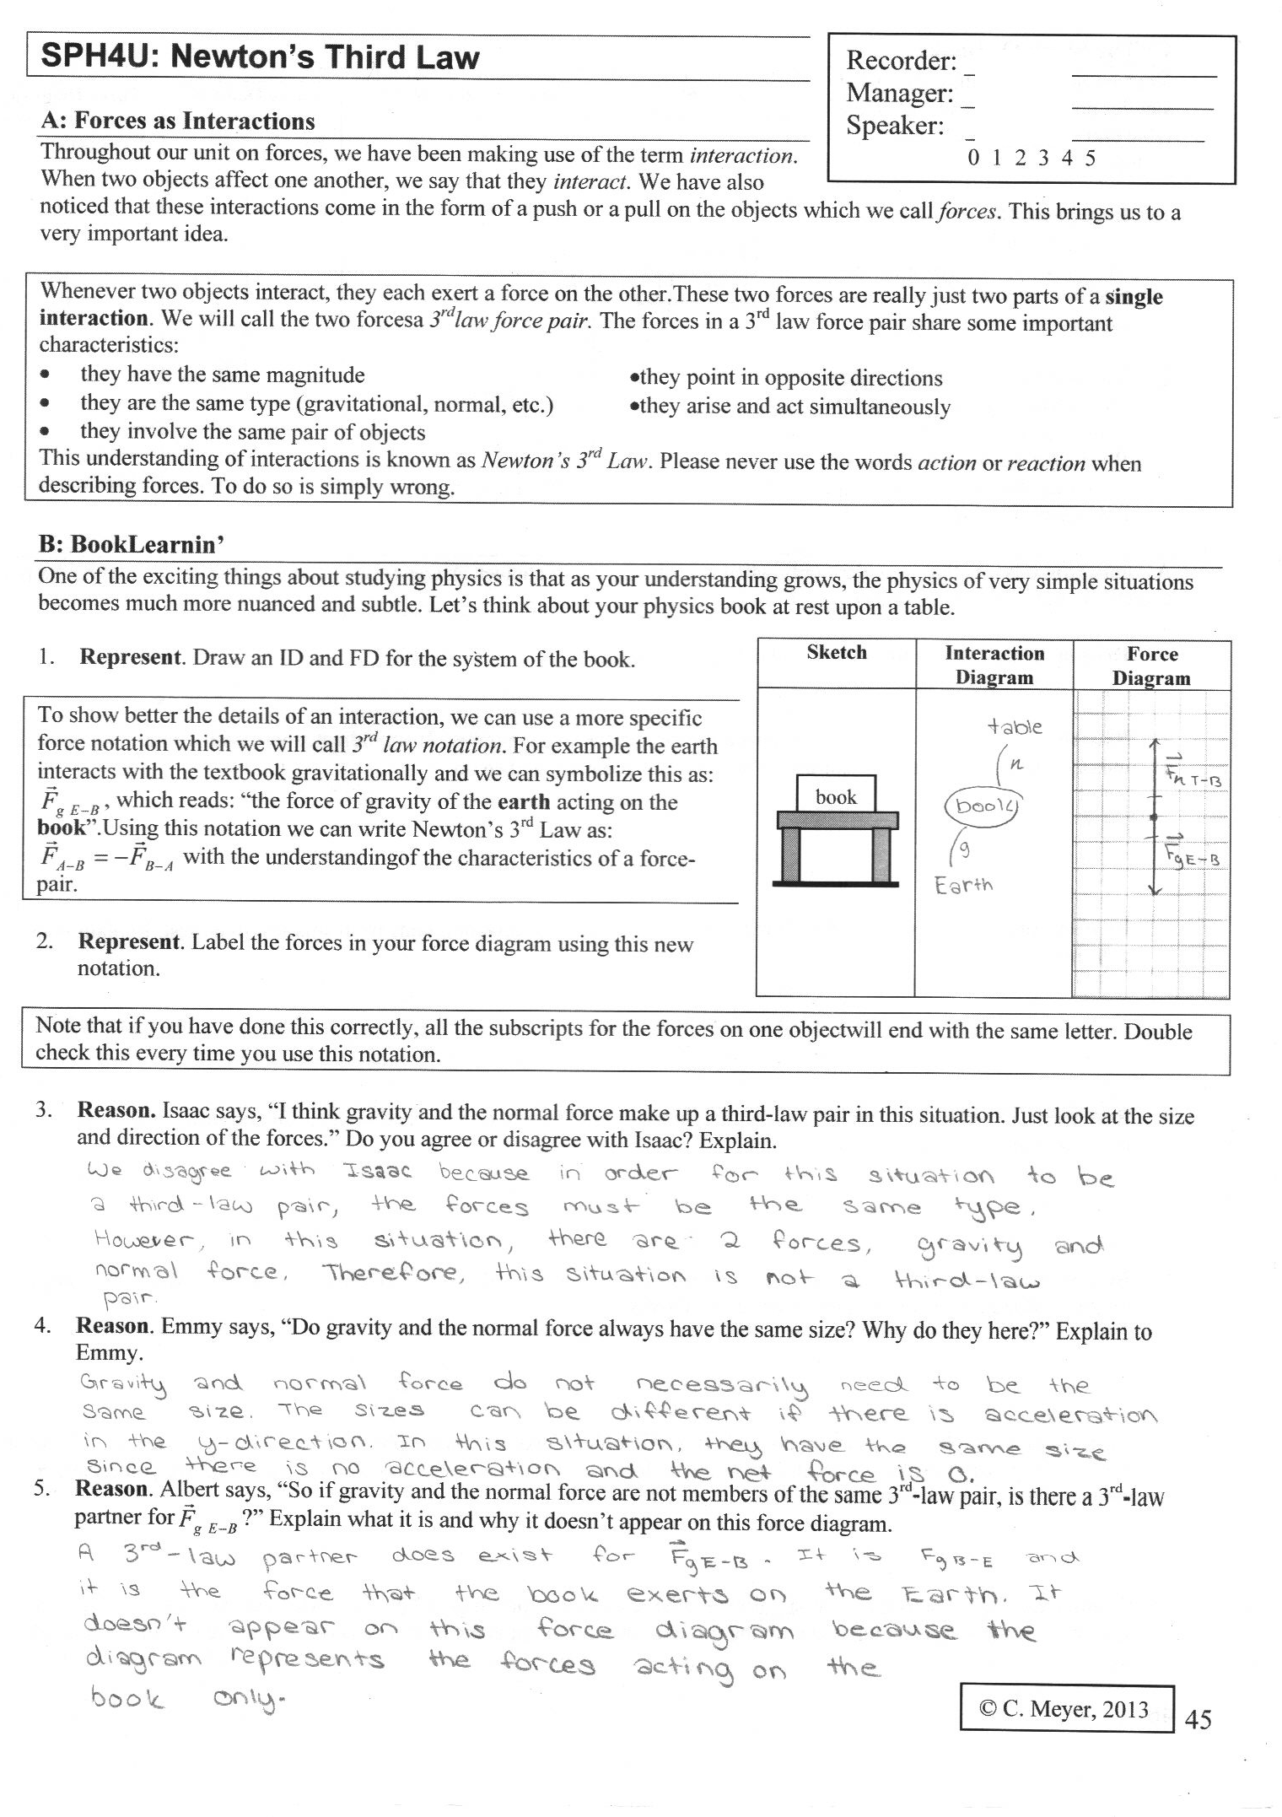
The Role of the Teacher
We don’t waste time delivering information.

Slide 42
Language!
Reformed classroom is very language intensive
Cooperative groups help english language learners

Slide 43
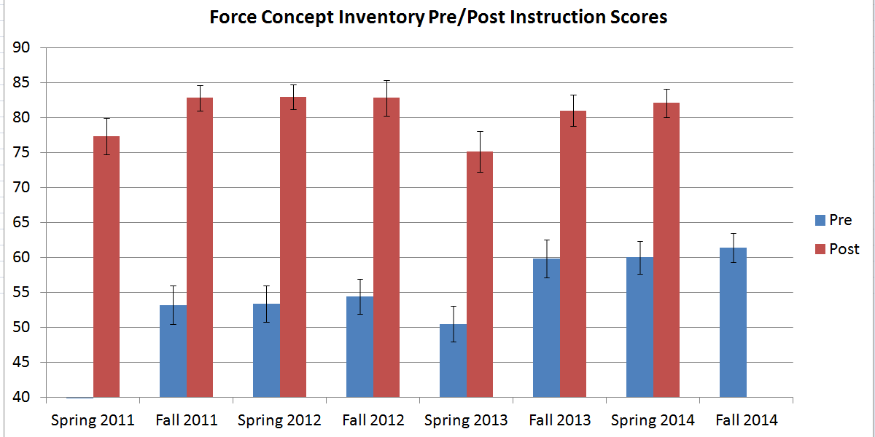
The Role of the Teacher
53.0%
Cohen’s d = 0.38
60.5%

Slide 44
Science!
Research
Model of Learning
Curriculum Development
Instruction

Slide 45
Traditional
Reformed

Slide 46
What have we learned about teaching?

Slide 47
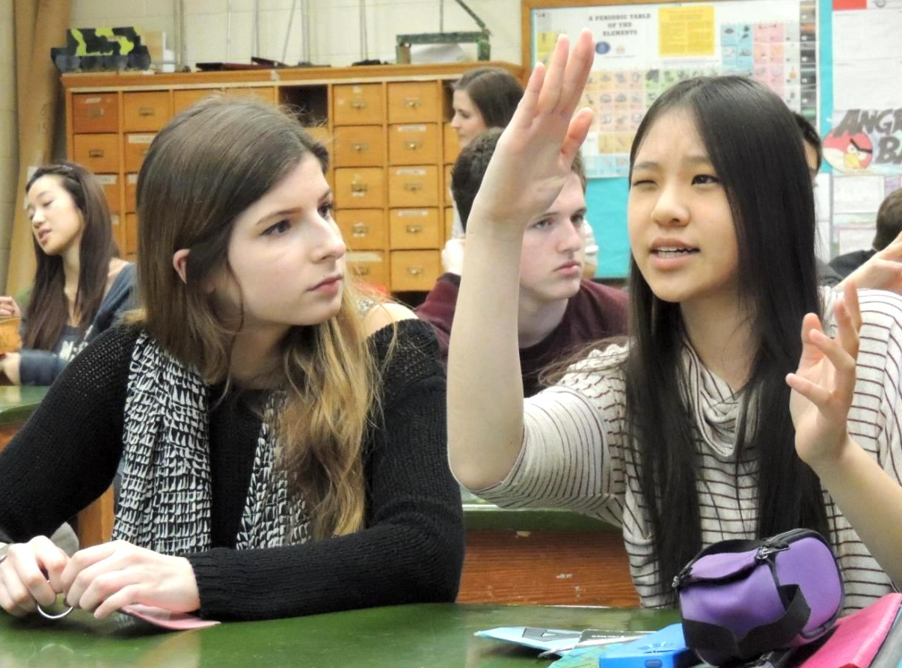
Active Learning is Key

Slide 48
What is Active Learning?
“Active learning engages students in the process of learning through activities and/or discussion in class, as opposed to passively listening to an expert. It emphasizes higher-order thinking and often involves group work.”
Freeman, Scott, et al. "Active learning increases student performance in science, engineering, and mathematics." Proceedings of the National Academy of Sciences (2014): 201319030.

Slide 49
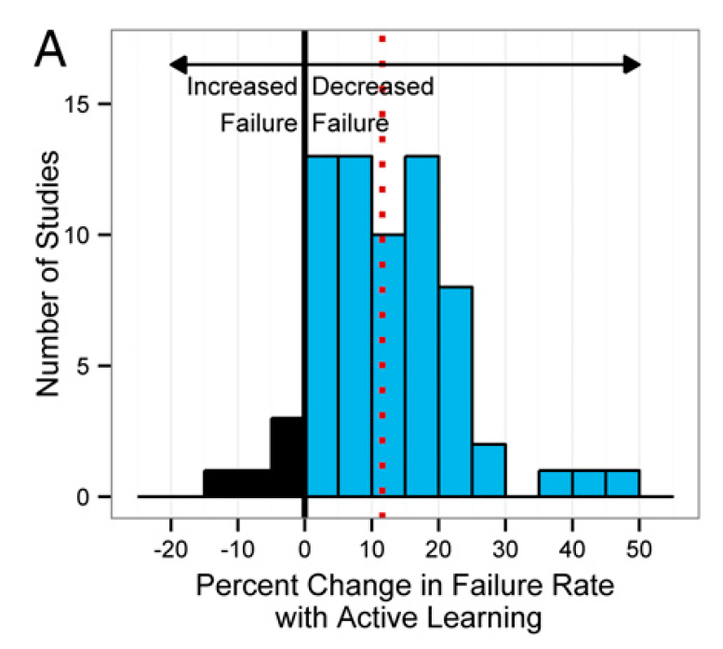

Slide 50
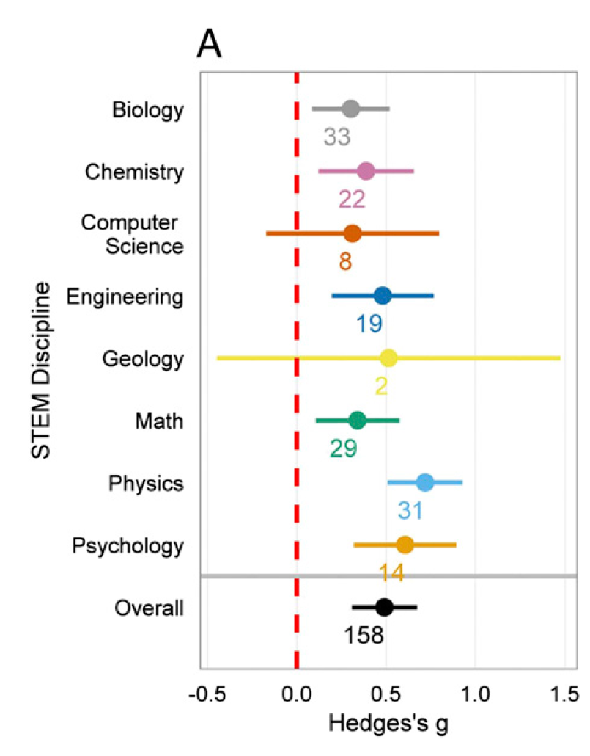

Slide 51
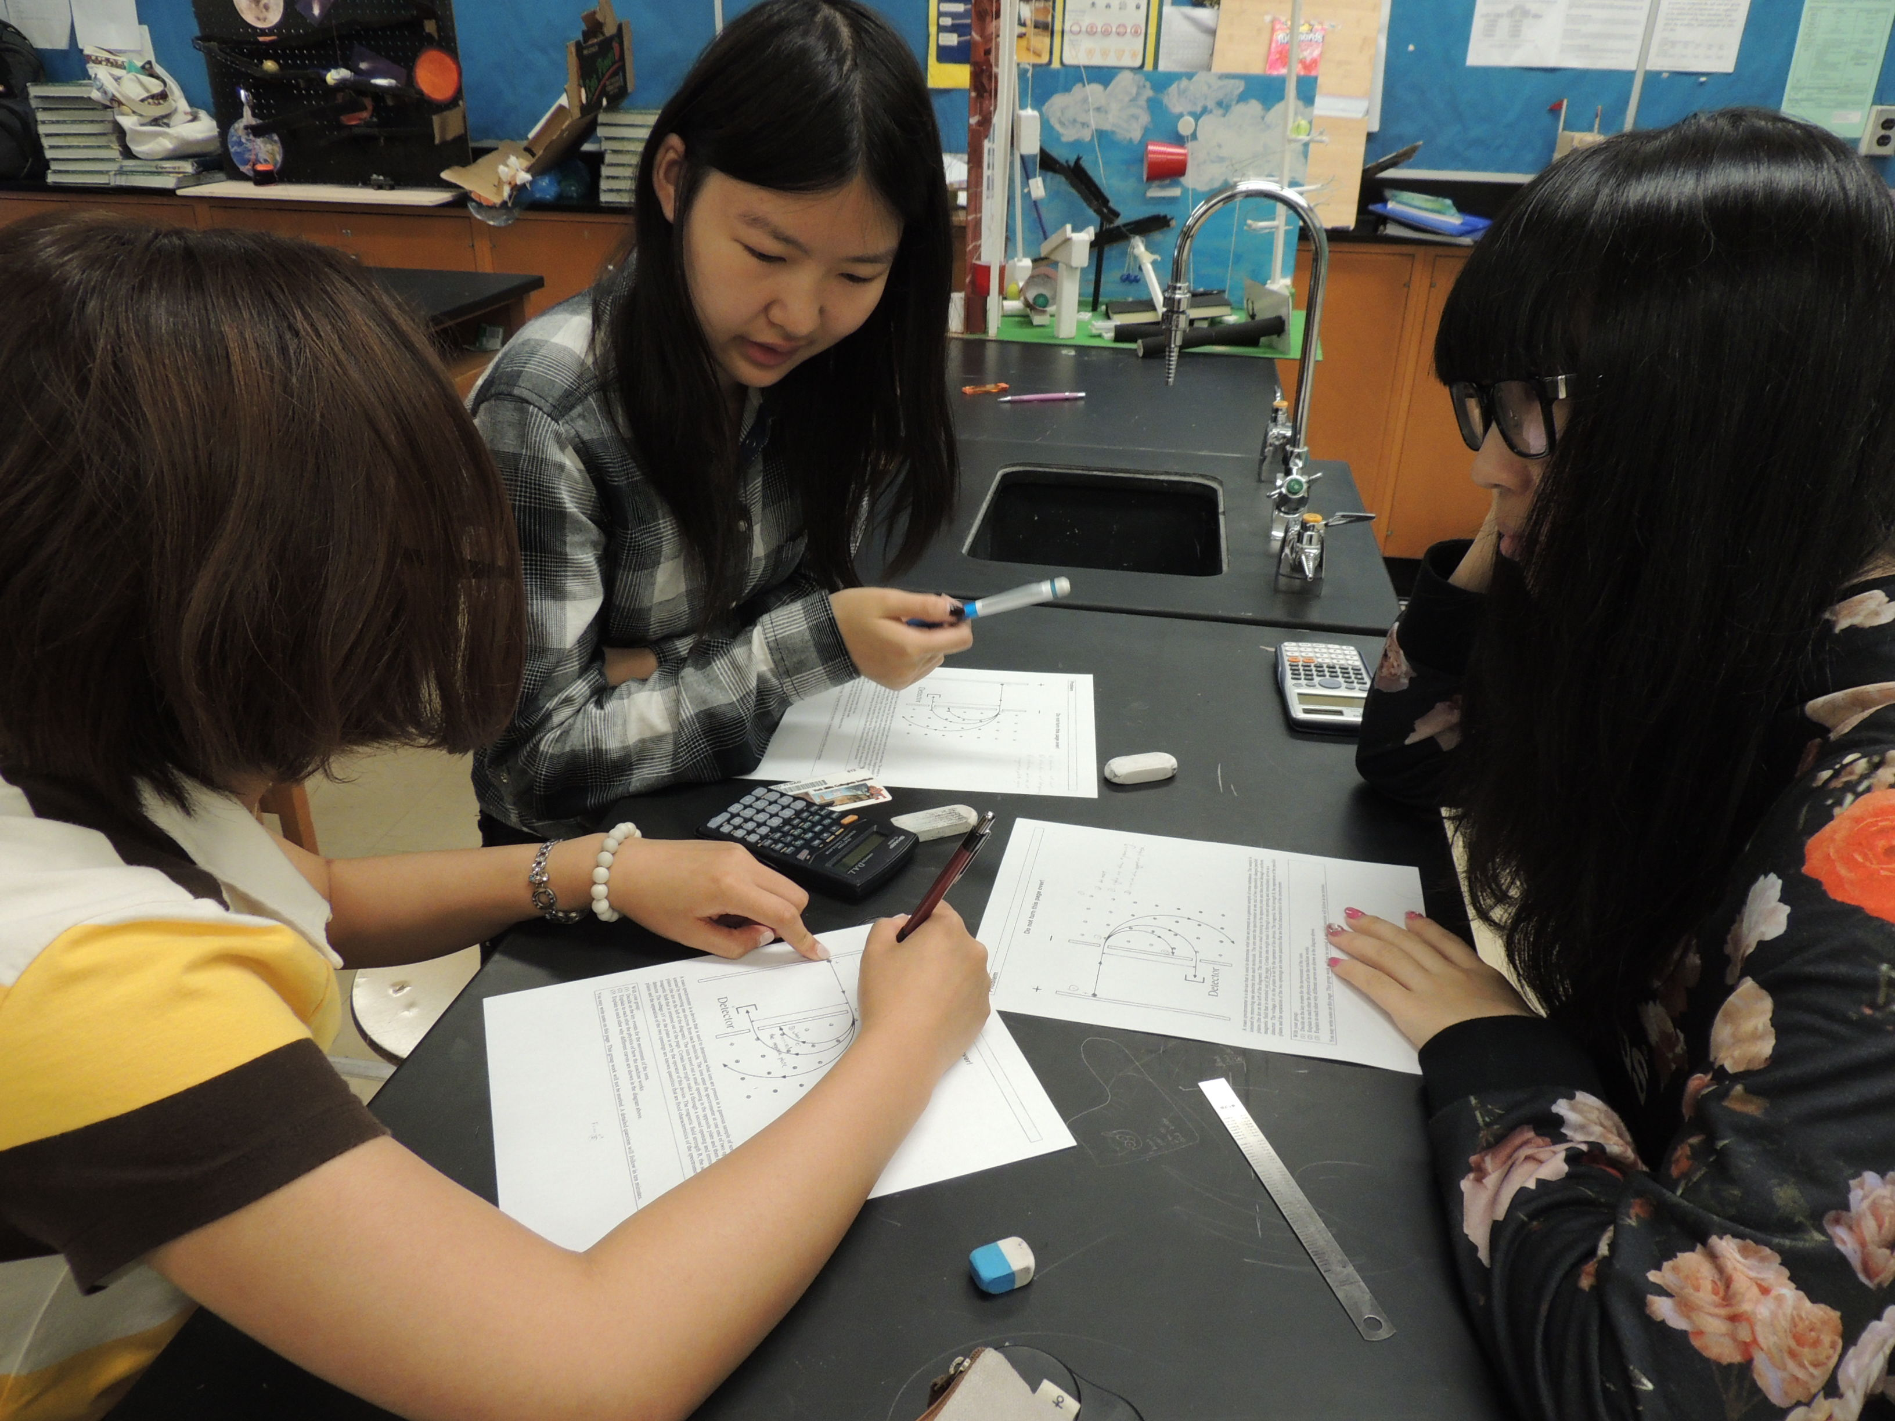
The Social Learning Principle
Humans learn best through social interactions

Slide 52
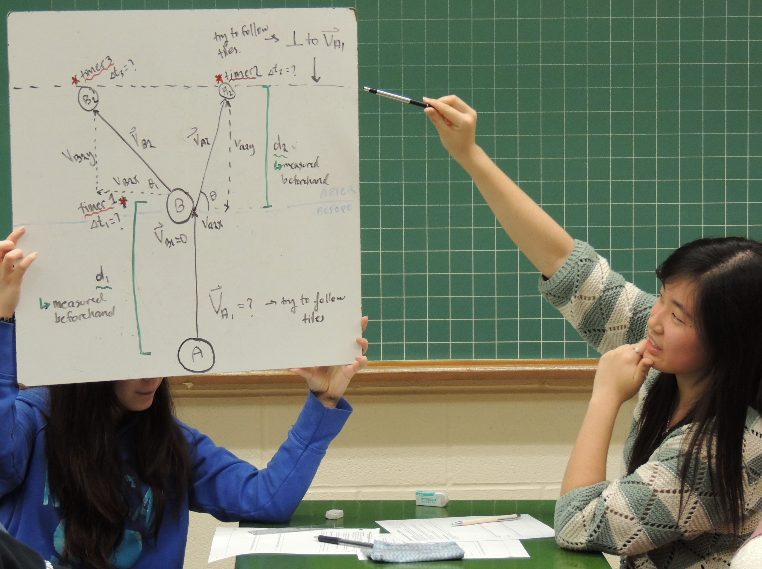
Train students in structured group work

Slide 53
Structured Group Work
Structured
Teacher chooses groups
Explicit roles
Together for extended time
Unstructured
Students choose groups
No roles
Together for a single class
Continuum

Slide 54
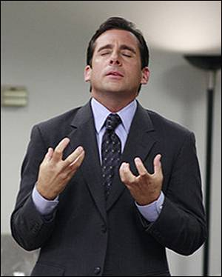
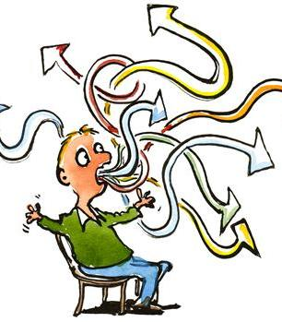
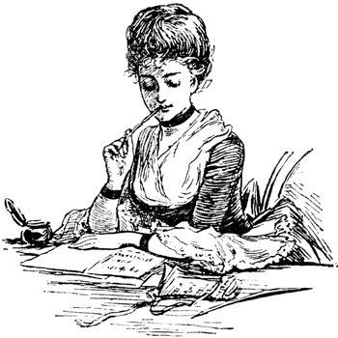
Structured Groups
Manager:
Focuses / organizes group
Recorder:
Writes on whiteboard
Checks group’s written work
Speaker:
Speaks on behalf of group, reads questions

Slide 55
Metacognition
Helping students monitor their own understanding and their process of learning

Slide 56
Group Discussion Process
How well did your group follow the group discussion process (every one share ideas, discuss, agree, write)?
A) With every group question
B) With most group questions
C) Occasionally
D) Rarely

Slide 57
Self-Regulation Check-Up
How well focused were you during today’s class?
A: Excellent – My attention was focused on physics tasks more than 90% of the time
B: Good – My attention was focused on physics tasks more than 80% of the time
C: OK – I was focused on the task 70% of the time, or I was somewhat distracted
D: Poor – I was focused for less than 70% of the time, or I was fairly distracted

Slide 58
Goal Setting
My goal for this unit of physics is:
(A) Complete homework more regularly
(B) Participate more in group discussions
(C) Drop by regularly at lunch for help
(D) Discuss carefully to build deeper understanding
(E) Get caught up on past material
(F) Be better prepared for class / on time

Slide 59
Feedback
Immediate and Targeted

Slide 60
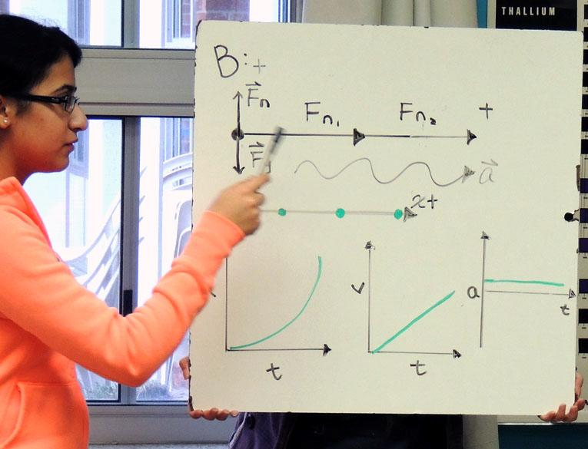
Feedback
Discussions
Shared work
MC answer cards
Self-evaluated quizzes

Slide 61
Prior Understandings
The knowledge and practices they bring into the class affect how they learn.

Slide 62
Common Difficulties
Study them.
Design lessons to elicit and resolve difficulties.

Slide 63
3. Reason. Isaac says, “I think gravity and the normal force make up a third-law pair in this situation. Just look at the size and direction of the forces.” Do you agree or disagree with Isaac? Explain.

Slide 64
Do not mistake yourself for your students
The fact that it worked for you only proves that it worked for you.
You suffer from expert blindness: You have forgotten what it’s like to learn to walk.

Slide 65

You are not the average person
ESL
Teacher

Slide 66
A Final Message

Slide 67
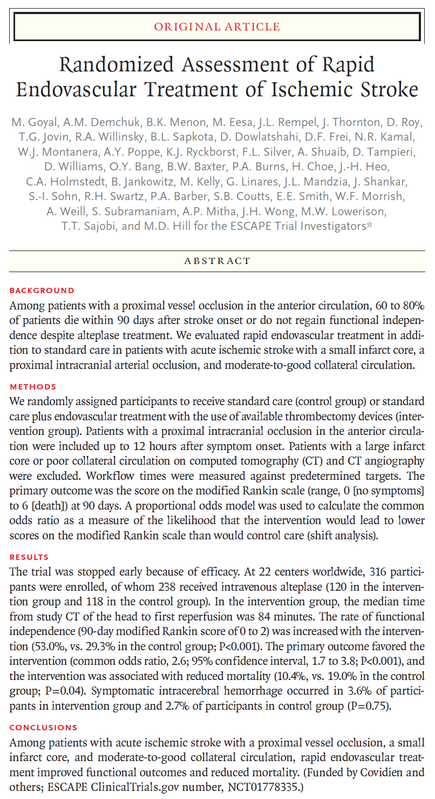
New England Journal of Medicine
Feb. 11, 2015

Slide 68
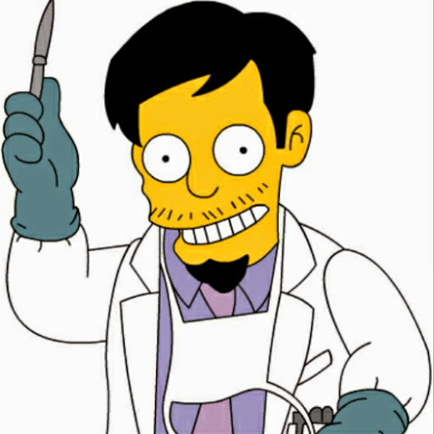
What would you do?

Slide 69
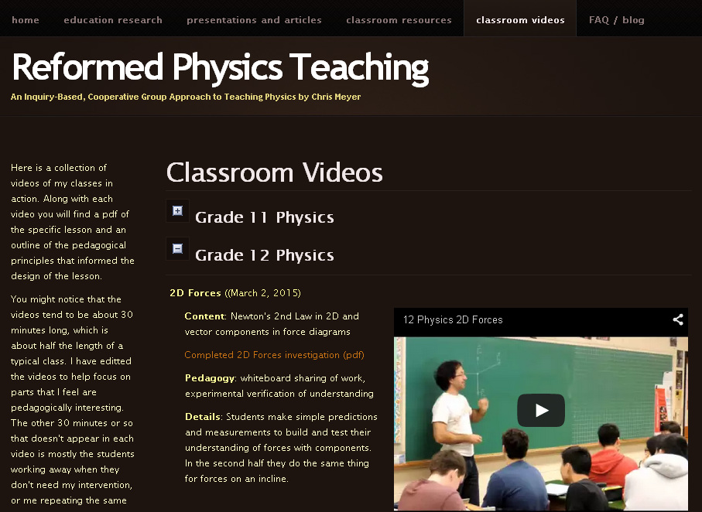

Slide 70

Essential
Reading!
Content Knowledge
Master Teacher
Pedagogical Knowledge
Download free: google “How People Learn”

Slide 71
Thanks!
Best Wishes Teaching!
Chris Meyer
chris@meyercreations.com
www.meyercreations.com/physics
google: “How People Learn”

